Slide 1
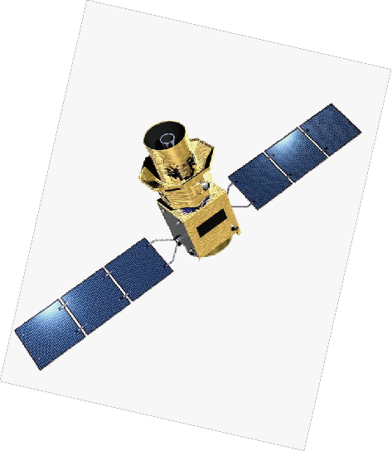
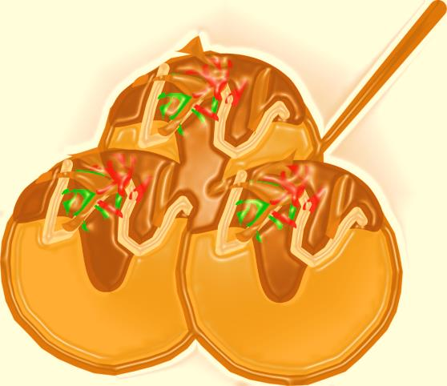
GRASPを用いた
CMB観測LiteBIRD衛星
光学系の検討
木村公洋(1)
井上将徳(1), 伊藤誠 (1),真鍋武嗣(1), 小川英夫 (1), 大西利和 (1), 関本裕太郎 (2), 稲谷順司 (2), 鹿島伸悟 (2), 松村知岳 (3) ,西堀俊幸 (4) , 菅井肇 (5) , 片山伸彦 (5) , 大田泉 (6) , 石野宏和 (7) , 羽澄昌史 (5) (8)
Osaka Prefecture University
National Astronomical Observatory of Japan (NAOJ)
Institute of Space and Astronautical Science (ISAS), Japan Aerospace Exploration Agency (JAXA)
Research and Development Directorate, Japan Aerospace Exploration Agency (JAXA)
Kavli Institute for the Physics and Mathematics of the Universe (Kavli-IPMU)
Konan University
Okayama University
High Energy Accelerator Research Organization (KEK)
Notes:
Thank you chair man. Good morning.
My name is kimihiro kimura, I belong to a Osaka prefecture university.
I would like to talk about a characterization of the Lite BIRD telescope using Physical Optics simulation.
I hope you will forgive me that I'm not good at English.
My talk wants to shorten it for coffee break

Slide 2
アウトライン
Introduction
GRASP simulation
Scale model measurement
Summery
Notes:
Here is an overview.
First, let me briefly introduce ,
and move on to antenna beam pattern simulation by GRASP
GRASP is antenna beam pattern calculation software.
and lastly to Scale model measurement and summery.
.

Slide 3
1) Introduction
Notes:
At first
I talk about antenna introduction

Slide 4
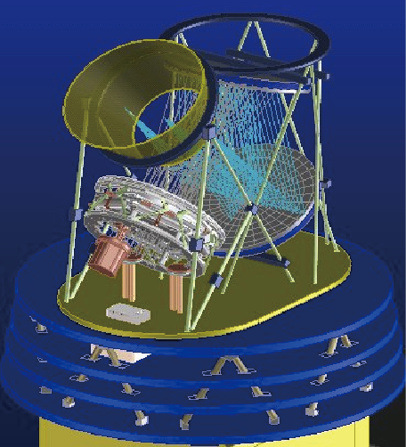
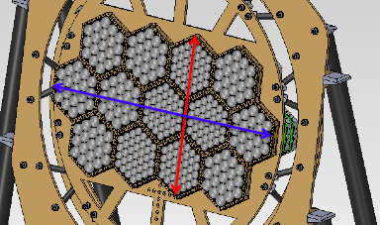
LiteBIRD アンテナ
  焦点面サイズ
  245mm×425mm
  アンテナサイズ
  less than 1.6m×1.6m
From space
Sub-ref.
Detectors
Main –ref.
245mm
425mm
冷凍機部分
Notes:
In this talk,
I mention a Low frequency telescope (LFT) only.
Lite BIRD satellite have a crossed doragone antenna.
Crossed dragone antenna consists of an aperture , main –reflector, sub-reflector and detectors.
It is for a characteristic of a cross dragon antenna to have large focal plane.
Lite Bird focal plane size is a about 245 times 425 square mm area.
Also
We have to make size less than 1.6m times 1.6m for a satellite telescope.

Slide 5
クロスドラゴンアンテナ
>メリット
大きな焦点面
コンパクトサイズ
>デメリット
迷光
多重反射
副鏡
フィード
主鏡
~1m
設計：CODE V and Light Tools
評価：CODE V, Light Tools
and GRASP
Notes:
This is a design of Lite BIRD crossed dragone antenna.
F number is 3.5.
A cross dragon antenna can have the large focal-plane area to the size of the whole.
But,
The distance between the mirrors is close.
We should be careful about multiple reflection and stray light
This design,
Kashima san designed it by COVE V and Lite Tools , these are optical design software.
But,
In mm wave band range,
These mirrors are very small to the wavelength.
It's difficult to estimate in detail using these software.
So We use a GRASP soft ware.
This software is often used for a design of a radio telescope, ALMA etc.

Slide 6
2) GRASP simulation
Notes:
Next,
I mention GRASP simulation and results

Slide 7
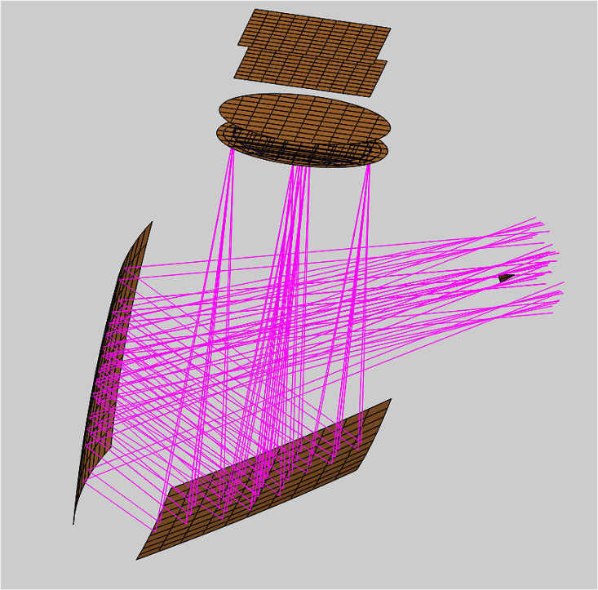
GRASPとは
GRASP(General Reflector Antenna Software Package)、ticra社
ミラー毎に、反射波は入射波から計算される。
Notes:
GRASP(General Reflector Antenna Software Package) is simulation software used by Physical optics.
Ticra company. @Denmark
A reflective wave is calculated from an incident wave every mirror.
1st, We define a feed radiation pattern
2nd , surface current of sub-ref is calculated by incident wave
3rd , The radiating pattern caused by sub-ref.surface current is calculated.
In this way,
GRASP is calculating beam propagation in turn.

Slide 8
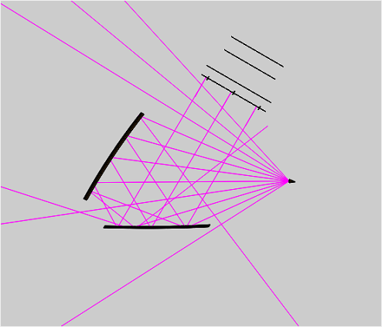
Lite BIRD GRASP シミュレーション
迷光、スピルオーバー、多重反射等
Antenna axis
計算条件
  ミラーのみ
  ミラーと開口
  ミラーとフード
  サイドバッフル
  Freq. 60 GHz
  Feed Conical horn
  光路 11 paths
副鏡
Feed
主鏡
Notes:
We calculated a Lite BIRD antenna beam pattern at mainly 4 conditions.
Like this.
And,,I calculated 60GHz
because Calculation time is short,
And, Influence of diffracting it is the biggest.
And Feed type was defined as conical horn as worst cace.
It has many side lobe pattern.

Slide 9
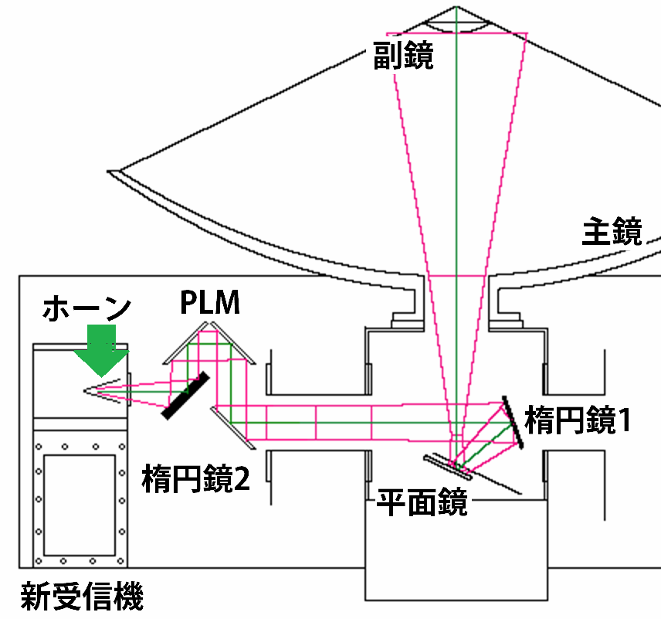
今までの望遠鏡ではあまり気にしていなかった。。。

Slide 10
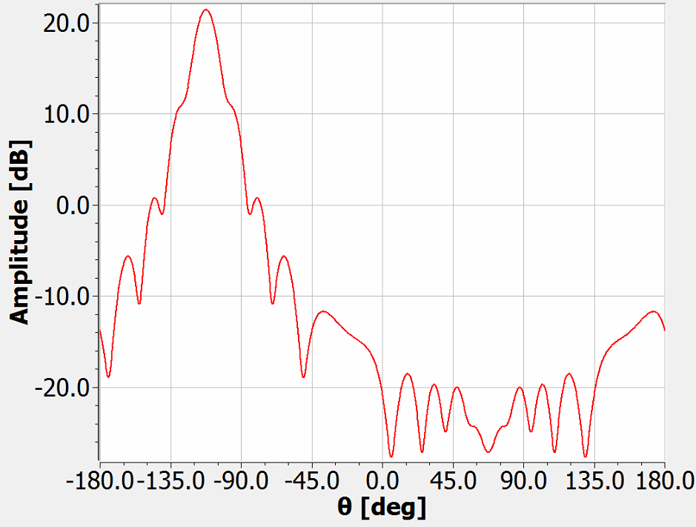
コニカルホーンパターン
θ=0deg
-110deg
ホーンの向き
90deg
-110deg
Notes:
This graph’s coordinate is defined like this .
Direction of main lobe is about – 110 degree is about correct.

Slide 11
Lite BIRD GRASP シミュレーション
Antenna axis
計算条件
  ミラーのみ
  ミラーと開口
  ミラーとフード
  サイドバッフル
副鏡
Feed
主鏡
Notes:
We calculated a Lite BIRD antenna beam pattern at mainly 4 conditions.
Like this.
And,,I calculated 60GHz
because Calculation time is short,
And, Influence of diffracting it is the biggest.
And Feed type was defined as conical horn as worst cace.
It has many side lobe pattern.

Slide 12
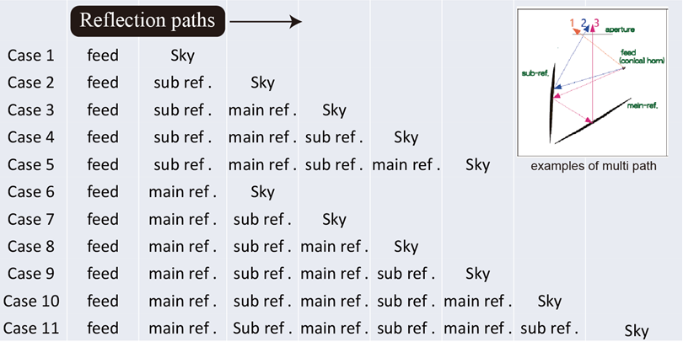
光路設定
Notes:
we supposed 11 ways of optical paths
Case 1 is that direct to the sky from feed horn.
Case 2 shows from horn to sub-ref to the sky
And, Case 3 is the main path that from horn to sub-ref to main-ref. to the sky
In addition to them,
Case 4 to 5 means multiple reflection path.
Example,
Case 4’s path shows from horn to sub-ref, to main-ref, to sub-ref again and to the sky.
Moreover,
I assumed the paths to the main-ref. directly from Horn.

Slide 13
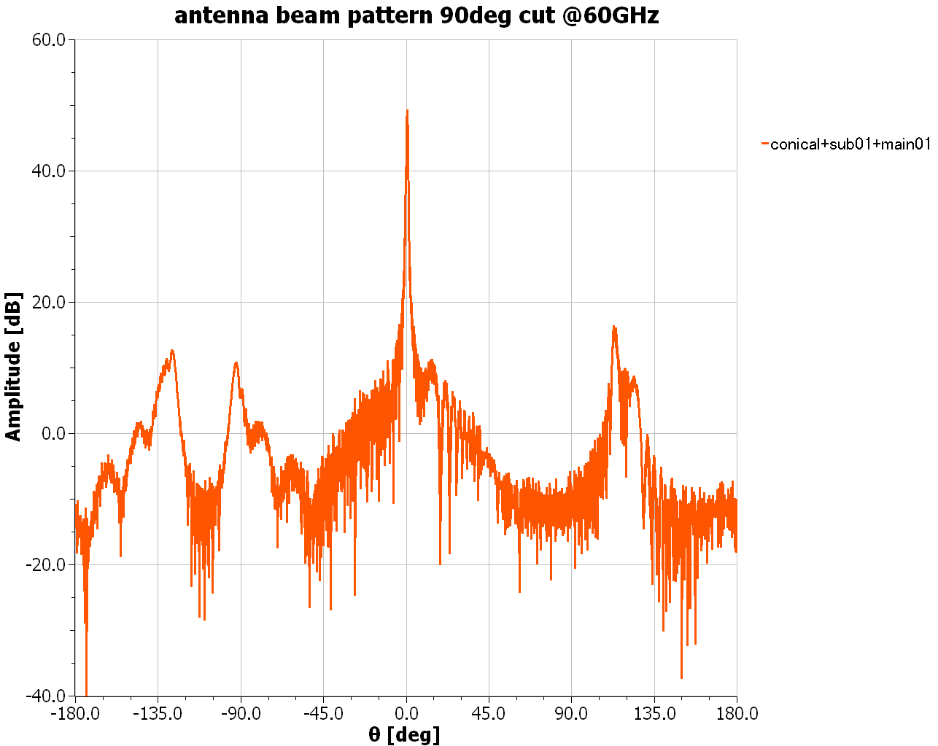
アンテナビームパターン
Optical path (Case1,2,3 feed -> Sub-ref. -> Main-ref.)
Main lobe
Sub-ref.
Feed
Main-ref.
Notes:
At farst,
I show a case 1,2,3 antenna beam pattern.
But, This is not so beautiful pattern.

Slide 14
アンテナビームパターン
Optical path (feed -> Sub-ref. -> Main-ref.)
Spillover@sub-ref.
Main lobe
Spillover
@main-ref.
Spillover@sub-ref.
Spillover at main-ref.
Notes:
Because,
Influence of spillover at sub-ref and main-ref appears these.

Slide 15
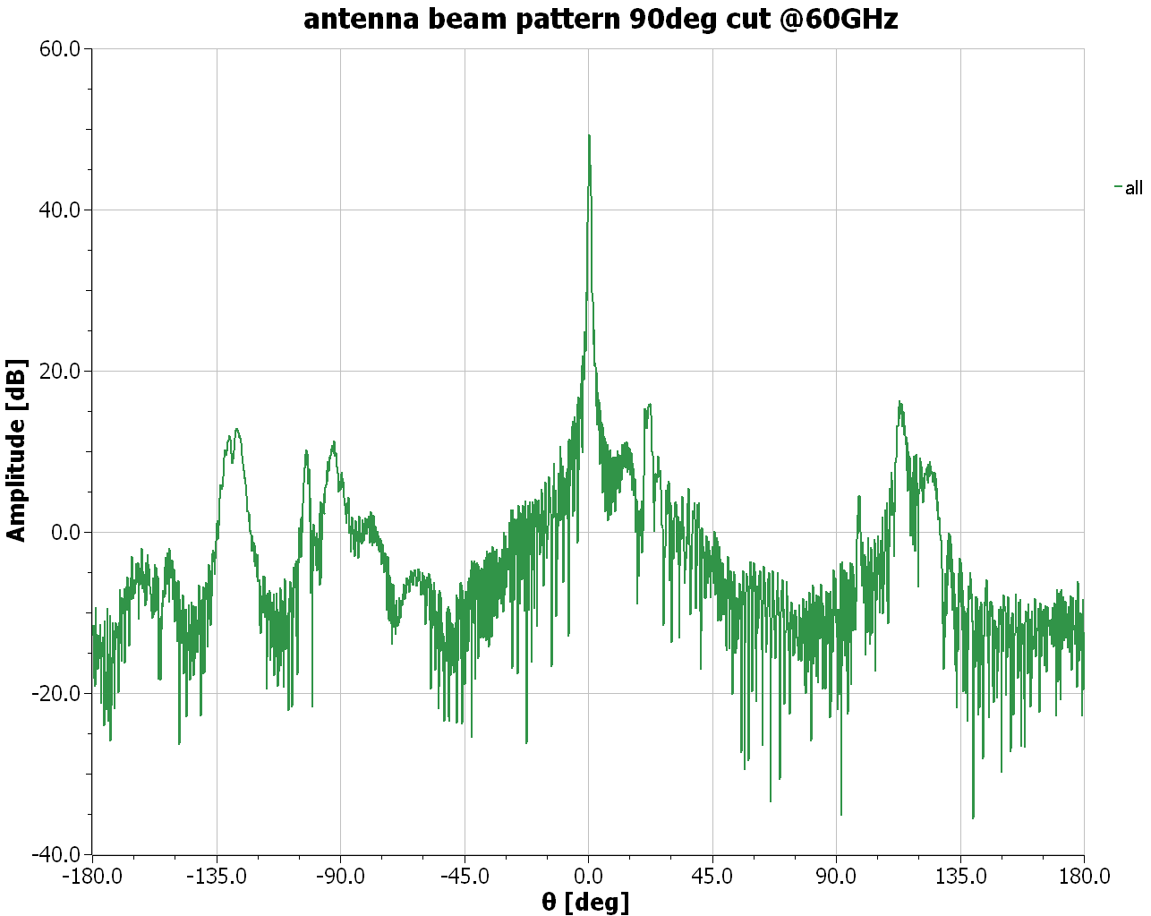
アンテナビームパターン
Optical path (Case1+2+…..+11)
Notes:
Next,
This radiation pattern include all 11 path that we suppose.
This doesn't also look too beautiful.

Slide 16
Antenna beam pattern
Optical path (Case1+2+…..+11)
Spillover
@main-ref.
Spillover@sub-ref.
Notes:
There are sidelobe patten by spillover.

Slide 17
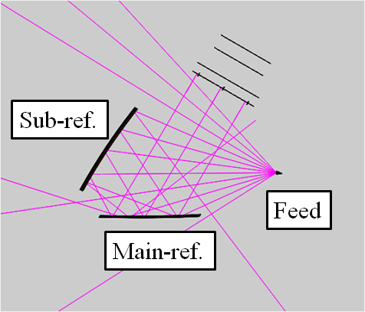
Antenna beam pattern
Optical path (Case1+2+…..+11)
Case 8
Feed -> Main-ref. -> Sub-ref. -> Main-ref.
-> sky
Case 6
Feed-> Main-ref.-> sky
Case 7
Feed -> Main-ref. -> Sub-ref. -> sky
Notes:
These sidelobe patterns are caused by a multiple reflection.
This is a case6 feed to main-ref to sky
This is a case 8 , feed to mainref to subref to mainref again to sky
And
This is by a case7
Then
We set an aperture to reduce a side lobe level.

Slide 18
Lite BIRD GRASP シミュレーション
Antenna axis
計算条件
  ミラーのみ
  ミラーと開口
  ミラーとフード
  サイドバッフル
副鏡
Feed
主鏡
Notes:
We calculated a Lite BIRD antenna beam pattern at mainly 4 conditions.
Like this.
And,,I calculated 60GHz
because Calculation time is short,
And, Influence of diffracting it is the biggest.
And Feed type was defined as conical horn as worst cace.
It has many side lobe pattern.

Slide 19
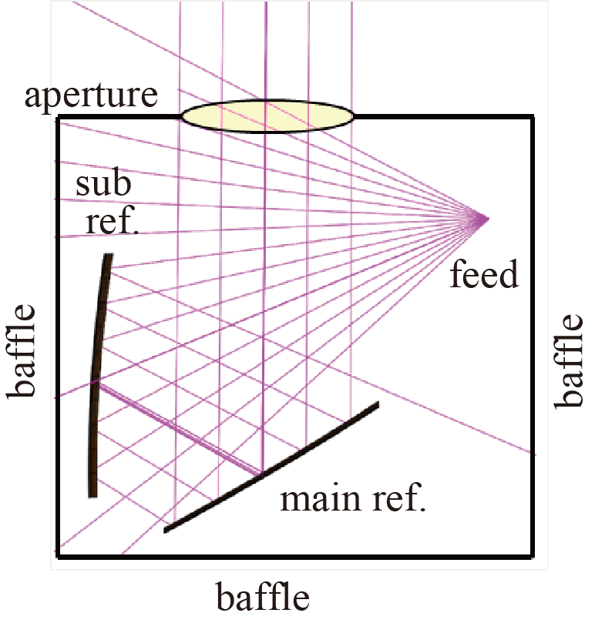
Lite BIRD GRASP シミュレーション
計算条件
  ミラーのみ
  ミラーと開口
  ミラーとフード
  サイドバッフル
直径400mm
Sum()
Case 1
Case 2
Case 3
・・・・・・
Case11
開口 => ビーム
パターン
(truncation)
Notes:
Like this
We absorb spillover and multiple reflection patterns at baffle
And
The entrance of radio wave assumed it only an aperture.

Slide 20
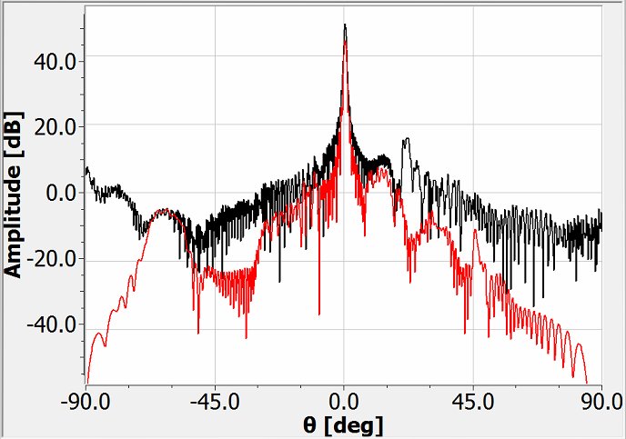
アンテナビームパターン
Optical path (Case1+2+…..+11)
1)
Black : ミラーのみ
Red: 開口
2)
1)
Case 8 のサイドローブは低減.
2)
ホーンのスピルオーバーは部分的に低減
3)
Case 11? は顕在化
3)
Case11 horn – main – sub – main – sub – main – sub - sky
Notes:
This graph shows a radiation pattern from aperture.
Black line is mirrors only pattern.
And red shows a beam pattern. from aperture
1)
Side lobe pattern by Case 8 is reduced.
2)
Influence of spillover is left a little.
3)
Pattern of Case 11ub appeared

Slide 21
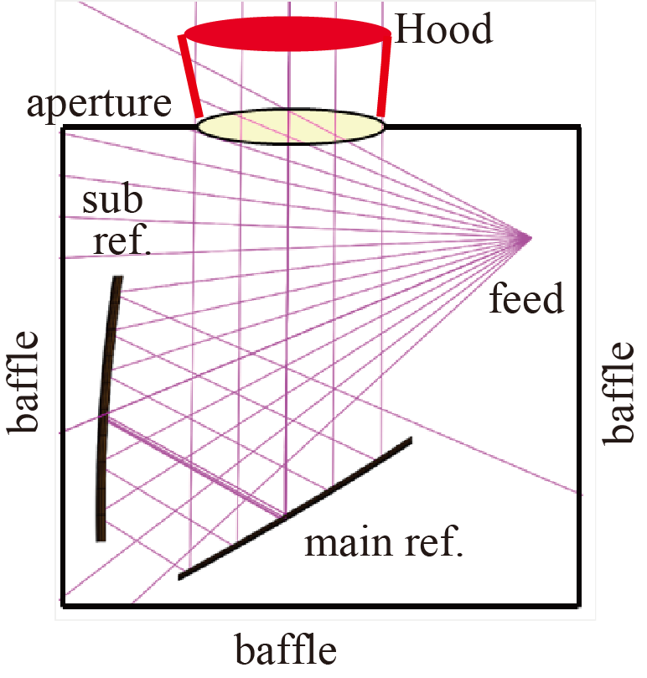
Lite BIRD GRASP シミュレーション
Dia. 500mm
計算条件
  ミラーのみ
  ミラーと開口
  ミラーとフード
  サイドバッフル
フード(out)
468mm
Dia. 400mm
フード(in)
Sum()
Case 1
Case 2
Case 3
・・・・・・
Case11
フード(in)=>フード(out)
=> ビームパターン
(truncation)
(truncation)
Notes:
Next,
we tried reduction of a side robe level by making an aperture a hood (like a pipe)

Slide 22
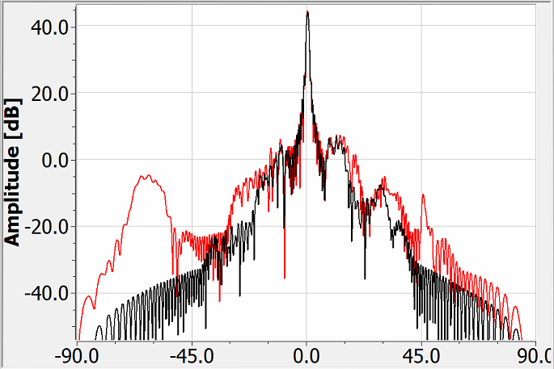
アンテナビームパターン
Optical path (Case1+2+…..+11)
Red: 開口
Black : フード
1)
ホーンスピルオーバーの低減
2)
Case 11パターンも
低減
3)
フードによってアンテナサイズが大きくなる.
1)
2)
Notes:
Red line is only aperture,
And Black line is with hood.
Far sidelobe level fell.
But ……
The antenna size became big by putting a hood.

Slide 23
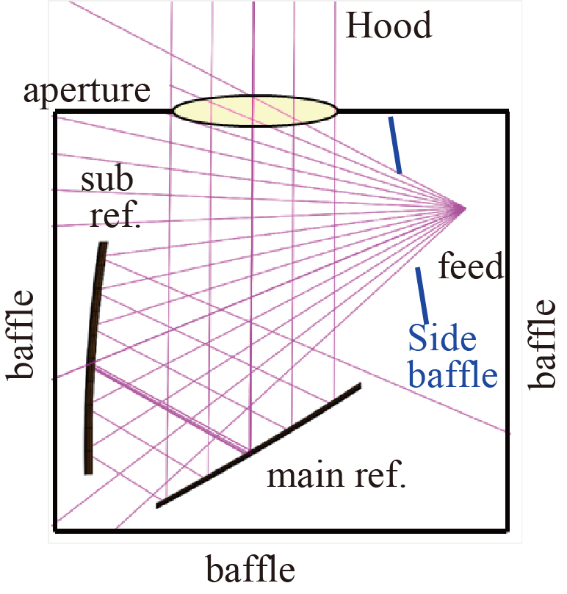
Lite BIRD GRASP シミュレーション
計算条件
  ミラーのみ
  ミラーと開口
  ミラーとフード
  サイドバッフル
ホーンからのサイドローブ
信号を直接終端する。
Notes:
Last,
We installed Side baffle in front of feed that reduced influence of
a multiple reflection by terminating a spillover of feed direct

Slide 24
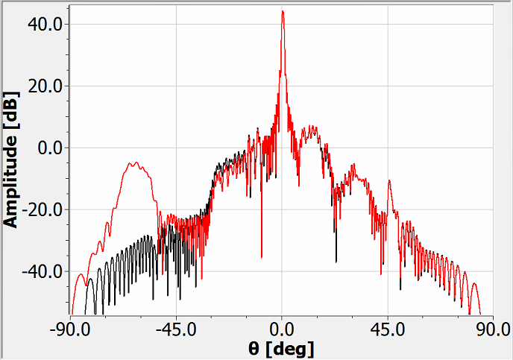
アンテナビームパターン
Optical path (Case1+2+…..+11)
Red: 開口
Black : サイドバッフル
1)
ホーンのスピルオーバーは低減
2)
Case11が残った。。
1)
2)
Notes:
Red line is a radiation pattern from aperture.
Black line is a with side baffle radiation pattern.
we can reduce a feed side lobe pattern like a with hood.
so
We're considering with side baffle design.

Slide 25
  3) Scale model measurement
1/3サイズ スケールモデルを製作、ビームパターン測定.
  1/3スケールモデル=> 低価格、扱い
  周波数 => 60 GHz×3 => 200 GHz band
目的
  シミュレーションとの比較 (multiple reflection etc.)
  フード、バッフル、サイドバッフル等のデザイン
Notes:
Next,
We produce 1/3(one third) models of a LiteBIRD Crossed Dragone antenna and evaluate of an optical characterization.
Small model is a easy handing and low cost
Measuring Frequency is 60 GHz band multiplied 3 is 200 GHz band
A purpose of this experiment are
Confirmation of simulation(multiple reflection etc.)
And Design of hood, baffle, side-baffle, etc.

Slide 26
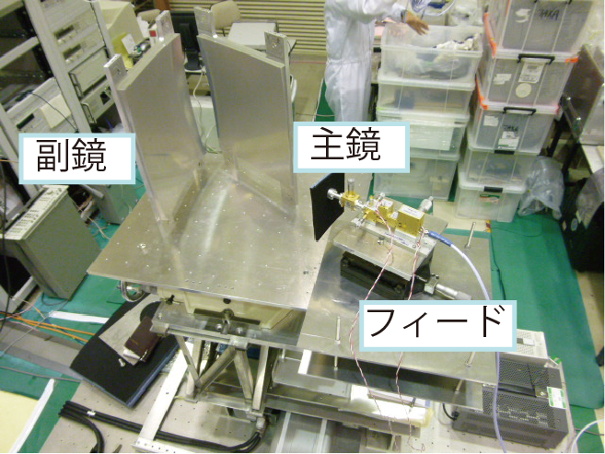
1/3 Scale model
Notes:
This photograph is a one third scale model of lite bird crossed dragone antenna.
This is a feed horn and multiplier. Subref and mainref.

Slide 27
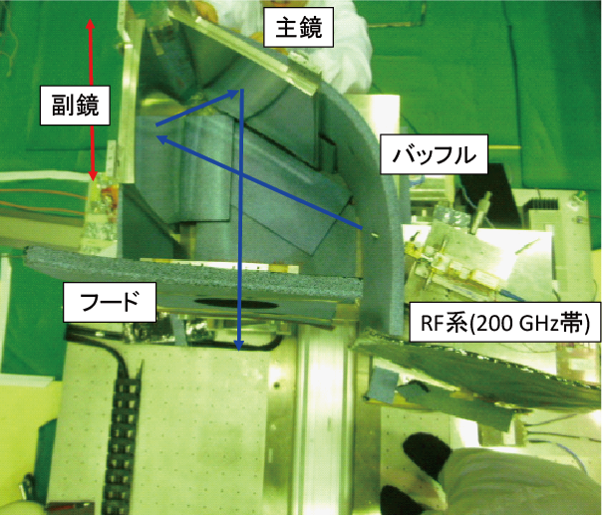
1/3 Scale model with 黒体
Notes:
this picture of the antenna which enclosed the environment by ecosorb and installed a hood aperture.

Slide 28
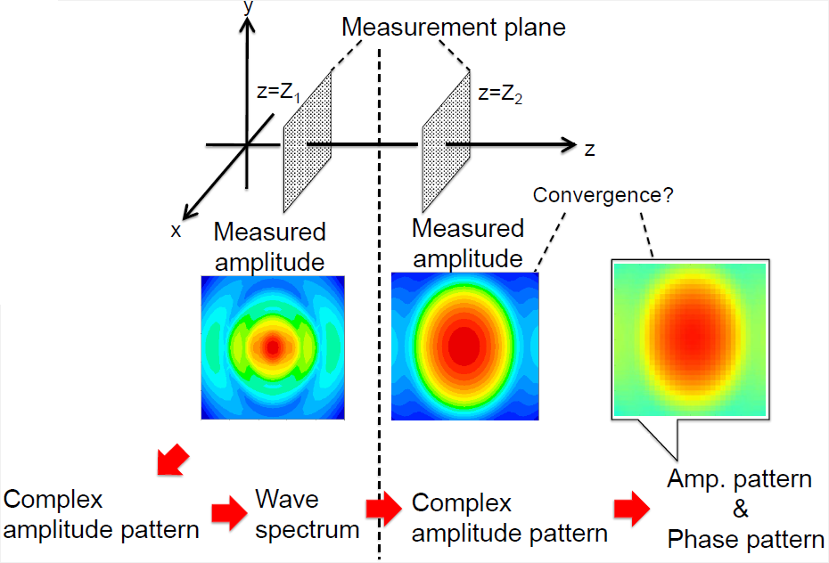
  3) Scale model measurement
  1) Phase retrieval method
Assumed
Phase pattern
Convergence
Fourier trans.
Inverse Fourier trans.
Notes:
This is a diagram of phase retrieval method.
We measure amplitude pattern at different positions.
Beam pattern is calculated by the assumed phase and a measured amplifier.
We can calculate far field pattern by making a calculation and an experiment agree.
It's compared with the amplifier which was measured at the location different from that.
We calculated a far field beam pattern.

Slide 29
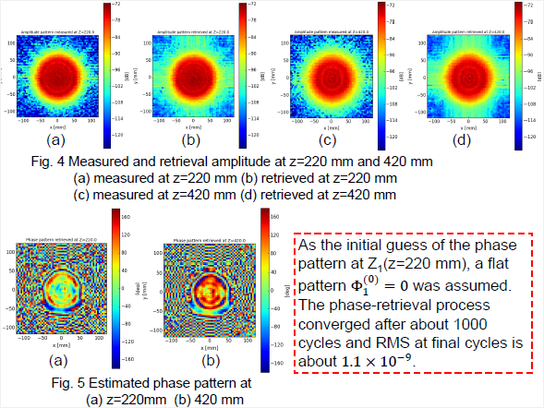
Preliminary results
Notes:
These are an preliminary results
A is a measured amplitude pattern at 220 mm
B is a calculated amplitude pattern at 220 mm
C,D are results of at 420 mm
The bottoms are the estimated phase pattern.
This phase retrieval process converged after about 1000 cycles and rms at
Final cycles is about 1 times 10^-9 (degree)

Slide 30
5) Summery
  物理光学(ＧＲＡＳＰ)を用いてクロスドラゴン型光学系の評価を行った。
  直径400mm程度のフードを用いることでサイドローブ強度は抑えることができた。
  コンパクト化の為にサイドバッフルを検討した結果、case11以外は軽減することができた。
  今後、フードやサイドバッフルの形状を最適化（コンパクトかつサイドローブ軽減）を進める。
  また、GRASP計算の検証等のために、1/3スケールモデルの製作を行い、測定評価を進めている。
Notes:
Last
We calculated an antenna beam pattern of Crossed Dragone antenna for Lite BIRD by GRASP(Physical optics method).
By installing a diameter of 400 mm aperture, it was possible to lower far-sidelobe level.
Also, Side baffle reduces a far-sidelobe level too.
We fabricated and measured the beam pattern using the 1/3 scale model antenna.
The phase-retrieval method was applied to the evaluation of beam pattern.
Now, we are preparing the measurement and analysis.

