Slide 1
ALMAの状況と将来計画
菊池健一（国立天文台）
2016/03/07-08, 第16回 ミリ波サブミリ波受信機ワークショップ（於電通大）

Slide 2
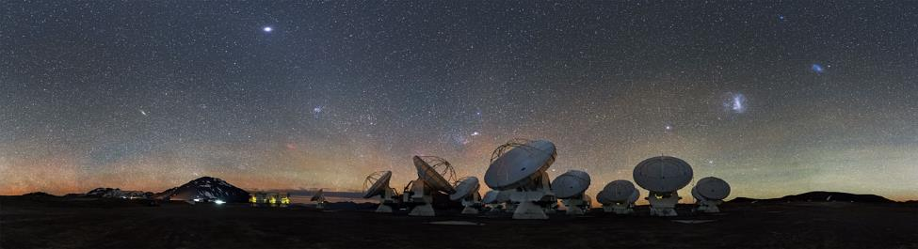
ALMA
Atacama Large Millimeter/submillimeter Array
南米チリのアタカマ高地（標高5,000ｍ）に建設した66台のアンテナ群「アタカマ大型ミリ波サブミリ波干渉計」
Credit: ESO
22ヶ国が参加する国際プロジェクト
「初期利用観測」を 2011 年に開始
2012年以降、300 を超える論文が発表されている (Nature誌11編、Science誌5編を含む)

Slide 3
ALMAの観測周波数帯
Band No. | RF Range, GHz |  | RX Type | IF Range, GHz |  | Ratio, RF/IF
1 | 35-50* | 15 | SSB | 4-12 | 8 | 1.9
2 | 67-90* | 23 | SSB | 4-12 | 8 | 2.9
3 | 84-116 | 32 | 2SB | 4-8 | 8 | 4.0
4 | 125-163 | 38 | 2SB | 4-8 | 8 | 4.8
5 | 163-211 | 48 | 2SB | 4-8 | 8 | 6.9
6 | 211-275 | 64 | 2SB | 5-10 | 10 | 6.4
7 | 275-373 | 98 | 2SB | 4-8 | 8 | 12
8 | 385-500 | 115 | 2SB | 4-8 | 8 | 14
9 | 602-720 | 118 | DSB | 4-12 | 16 | 7.4
10 | 787-950 | 163 | DSB | 4-12 | 16 | 10

Slide 4
ALMAの観測周波数帯
Band No. | RF Range, GHz |  | RX Type | IF Range, GHz |  | Ratio, RF/IF
1 | 35-50* | 15 | SSB | 4-12 | 8 | 1.9
2 | 67-90* | 23 | SSB | 4-12 | 8 | 2.9
3 | 84-116 | 32 | 2SB | 4-8 | 8 | 4.0
4 | 125-163 | 38 | 2SB | 4-8 | 8 | 4.8
5 | 163-211 | 48 | 2SB | 4-8 | 8 | 6.9
6 | 211-275 | 64 | 2SB | 5-10 | 10 | 6.4
7 | 275-373 | 98 | 2SB | 4-8 | 8 | 12
8 | 385-500 | 115 | 2SB | 4-8 | 8 | 14
9 | 602-720 | 118 | DSB | 4-12 | 16 | 7.4
10 | 787-950 | 163 | DSB | 4-12 | 16 | 10

Slide 5
ALMAの観測周波数帯
Band No. | RF Range, GHz |  | RX Type | IF Range, GHz |  | Ratio, RF/IF
1 | 35-50* | 15 | SSB | 4-12 | 8 | 1.9
2 | 67-90* | 23 | SSB | 4-12 | 8 | 2.9
3 | 84-116 | 32 | 2SB | 4-8 | 8 | 4.0
4 | 125-163 | 38 | 2SB | 4-8 | 8 | 4.8
5 | 163-211 | 48 | 2SB | 4-8 | 8 | 6.9
6 | 211-275 | 64 | 2SB | 5-10 | 10 | 6.4
7 | 275-373 | 98 | 2SB | 4-8 | 8 | 12
8 | 385-500 | 115 | 2SB | 4-8 | 8 | 14
9 | 602-720 | 118 | DSB | 4-12 | 16 | 7.4
10 | 787-950 | 163 | DSB | 4-12 | 16 | 10

Slide 6
ALMA 共同利用観測
 | Cycle 0 2011.10-2012.12 | Cycle 1 2013.01-2014.05 | Cycle 2 2014.06-2015.09 | Cycle 3 2015.10-(2016.09)
Time (12-m time) | 500 hours | 800 hours | 2000 hours | 2100 hours (for 12 months)
Bands | 100, 230, 345, 690 GHz (Bands 3,6,7,9) |  | 100, 150, 230, 345, 450, 690 GHz (Bands 3,4,6,7,8,9) | 100, 150, 230, 345, 450, 690, 900 GHz (Bands 3,4,6,7,8,9,10)
Antennas | > 16 x 12m | 32 x 12m 9 x 7m 2 x 12m TP | 34 x 12m 9 x 7m 2 x 12m TP | 36 x 12m 10 x 7m 2 x 12m TP
Baselines | Max 400 m | Max 1 km | Max 1 km (B8,9) Max 1.5 km (B3,4,6,7) | Max 2 km (B8, 9,10) Max 5 km (B7) Max 10 km (B3, 4, 6)
Other capabilities |  |  | Spectral scan Polarization | Spectral scan Polarization
Notes:
May skip this slide

Slide 7
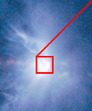

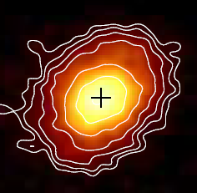
超高解像度観測
「視力2000」で惑星の誕生現場を撮影
CARMA (Kwon et al. 2011)
ハッブル宇宙望遠鏡
ハッブル宇宙望遠鏡
アルマ望遠鏡
分解能：0.08秒角
分解能：0.035秒角
分解能：0.15秒角
星雲の奥深くに潜む惑星誕生現場を明瞭に撮影。惑星ができている証拠である円盤内の何本もの溝を、世界で初めて撮影に成功。
ハッブル宇宙望遠鏡やCARMAなど、既存の最高性能望遠鏡の
画像を大きく凌駕する観測成果。
ALMA Partnership et al. Astrophys. Journal Let. 2015

Slide 8
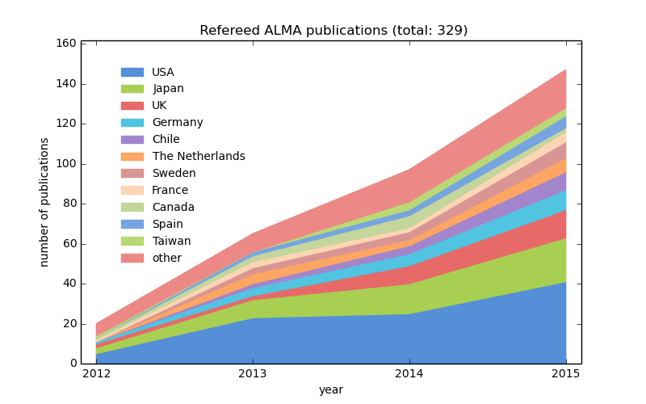
ALMA 論文数の推移(各年の論文数)
Notes:
May skip this slide

Slide 9
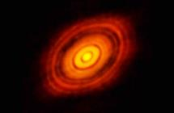
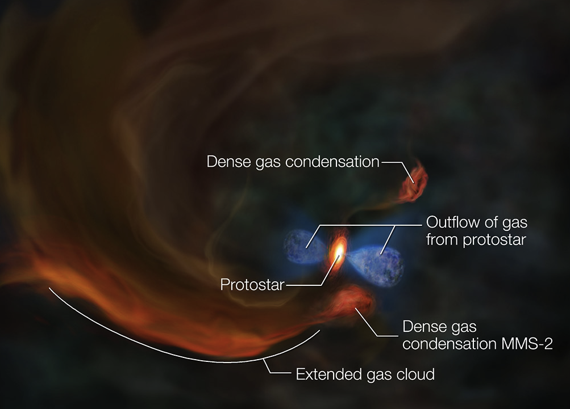
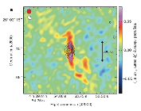
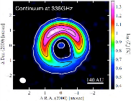
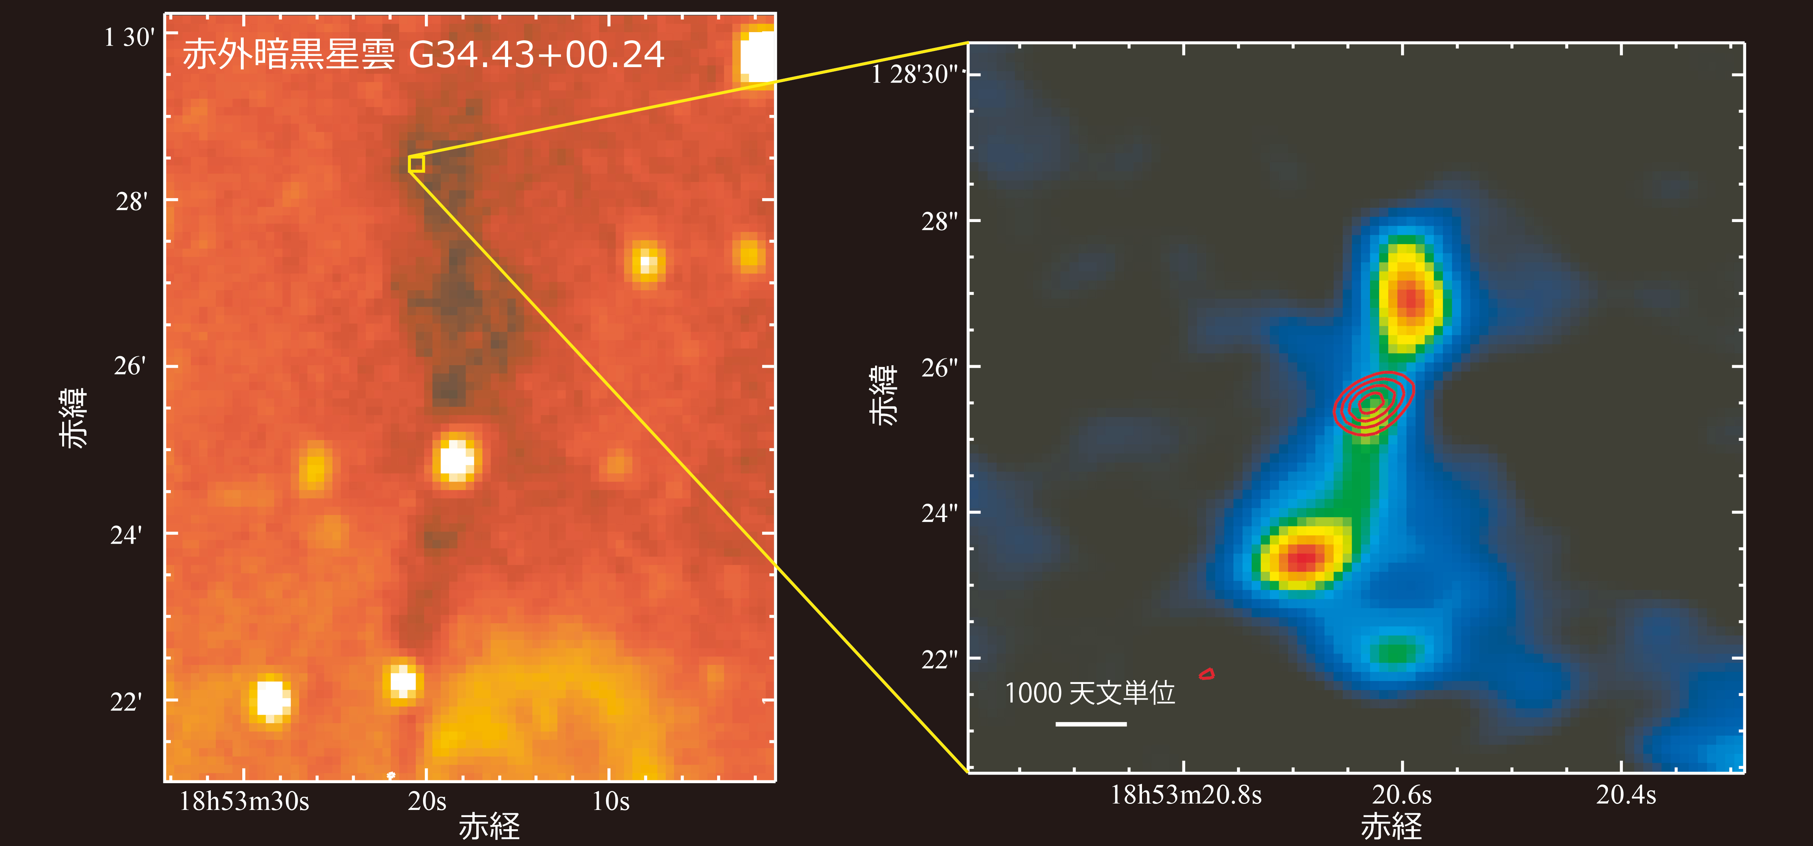
Concept of ALMA Development
ALMA is already producing 300+ papers.
ALMA’s lifetime is 30+ years (we still have 25+ years to go)
What will be the important next addition/upgrade to ALMA?
ALMA Future Development Studies and Projects

Slide 10
Concept of ALMA Development
Motivated by science – e.g.
  a complete new addition to the array,
  extension of existing capabilities (e.g. higher sensitivity, wider bandwidth, improved image quality, better dynamic range)
  improvements to existing systems (in hard- or software).
Near term (~ 5 yr) EA studies and development
  Band 1 (led by ASIAA (Taiwan))
  Terahertz studies
  ALMA Calibration Source
Longer term (~ 10 yr) EA studies and development
  Multi-beam receiver (+ spectrometer)
  Ultra-wideband receiver

Slide 11
Priorities for EA
Studies & Small Projects
  ALMA Calibration Source
    Calibration at bands 3,6,7
  High Critical Current Density (Jc) SIS Junction Device Development (including THz devices)
  GPU Spectrometer for TP array (with KASI)
    Supplements the ACA correlator
Projects
  Band 1 project (lead: ASIAA, Collaboration: NAOJ, U of Chile, NRAO, HIA)
    Baseline capability (35-50GHz)
ASTE development project (but extendable to ALMA)
  Multi-beam receiver (with KASI)

Slide 12
Collaboration with EU/NA
Studies & Small Projects
  Band 2 (NA), Combining Band 2 and 3 (EU)
    EA contribution: Optics design
Projects
  Band 5
    EA contribution: Front end integration at the OSF

Slide 13
Timeline
 | 2016 | 2017 | 2018 | 2019
Band 1 (w/ ASIAA) | CDR/Proj Review MRR |  |  | AIV
Calibration Source | 100GHz source testing |  | 200-300 GHz source delivery
TP Spectrometer (w/ KASI) | Seek board approval PDR | CDR | AIV
High Jc SIS Device | research | research
Multi-beam for ASTE (w/ KASI) | PDR/CDR | Installation

Slide 14
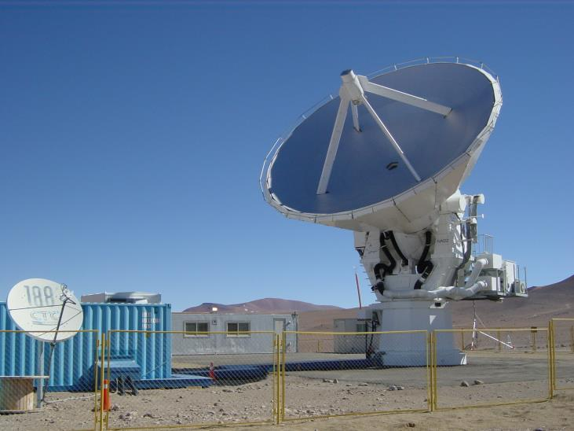
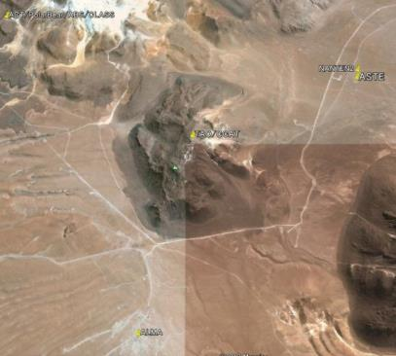
ASTE 10m Telescope
Atacama Submillimeter Telescope Experiment
Location: Pampa la Bola, Atacama Desert
Northern Chile
Altitude : 4,800 m
Surface accuracy: 19μm
Pointing accuracy: 2” rms
NANTEN2
TAO/CCAT
ASTE
APEX
ALMA

Slide 15
ASTE in the era of ALMA
Synergy with ALMA
  To maximize the science output of ALMA from EA, operation/instrument plans of ASTE to reflect opinions from the community.
  Test bench for new technologies
    Multi-beam heterodyne receiver, ALMA Band11, etc
    → possibility of future development projects of ALMA
    TES bolometer camera + Polarimeter, DESHIMA/MOSAIC, etc
    → Complementary to the ALMA

Slide 16
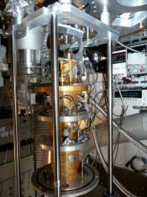
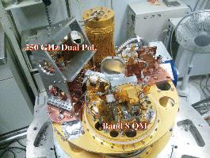
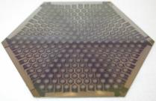
ASTE Current Receivers
Instrument | Type | Freq. [GHz] | HPBW [arcsec] | Npix | Npol
CATS345 | Heterodyne | 324-372 | 22 | 1 | 1
DASH345 | Heterodyne | 324-372 | 22 | 1 | 2
Band8 | Heterodyne | 400-500 | 17 | 1 | 2
THz-RX | Heterodyne | 800-900 | 10 | 1 | 1
 |  | 1300-1500 | 7 | 1 | 1
TES Camera | Bolometer | 270 | 28 | 169 | -
 |  | 350 | 22 | 271 | -
270GHz TES bolometer array
CATS345
80mm

Slide 17
Candidates for ASTE Future Instruments
Instrument | PI | Type | Npix | Freq. [GHz] | Resolution [df/f or Hz] | Note
DESHIMA | A. Endo (TU Delft) | MKIDs | 7 | 326-905 | 500
“A-Pol” added on ASTECAM | H. Li (CUHK) | Polarimeter | - | 240-370 330-710 | - | WG+HWP Stokes: Q/U
Multi-beam RX + Spectrometer | JW. Lee (KASI) | Heterodyne | 32 (Max. 64) | 300-500 | 7.6 kHz (BW 4GHz) | Single Pol. 2SB
Reference: ASTE/ALMA Development Workshop 2014
http://alma-intweb.mtk.nao.ac.jp/~diono/meetings/ASTE_ALMA_2014/program.html

Slide 18
本ワークショップでの発表
伊藤哲也 「ASTE 3カートリッジデュアに対応した DASH345 および Band8 受信機の改修」
Alvaro Gonzarez “Design of ALMA band 1 (35-50 GHz), 2 (67-90 GHz) and 2+3 (67-116 GHz) optics at NAOJ”
金子慶子 「40GHz帯コルゲートホーンの試作」
池谷瑞基 「SISミキサの広帯域化に向けたNb/Al/AlOx/Al/Nb接合の研究」
稲田素子 「ASTE 新３カートリッジデュア評価試験」
上月雄人 「275-500GHz SIS ミクサの設計」
Matthias Kroug “High-Jc SIS Mixers for a 300-500 GHz Receiver”
小嶋崇文 「冷却プローバーを用いたSIS接合のキャパシタンス測定」
高橋宏明 「冷却TRL校正による電波天文用マイクロ波帯低雑音アンプの特性評価手法の確立」
Alvaro Gonzarez “Novel reconfigurable beam measurement system and measurements in the 1.25-1.57 THz band”

Slide 20
East Asian ALMA Development
2011
EA ALMA Development WS
Output: three EA led projects/studies
Band 1
Band 11
Artificial Calibration Source
Output: New science demands for ALMA
2013
EA ALMA Development WS
Angular Res.
Fidelity
FOV
Sensitivity
Wide IF
2014
EA ASTE/ALMA Development WS
Multi-beam
THz
TES Cam
Wideband Spectrometer
Output: Science requirements, ASTE/ALMA dev timeline.

Slide 21
ALMA Science Advisory Committee
Recommendation for 2030
  Better archive and tools
  Improving Rx with wider bandwidths
    Goal to correlate the entire band in one observation
  Longer baselines
    Real-time correlation (instead of VLBI techniques)
  Long-term research on wide-field imaging
    Multi-beam receivers

Slide 22
EA ALMA Future Development
Near term (~< 5 yr) studies and development
  Band 1 (led by ASIAA)
  Terahertz studies
  ALMA Calibration Source
Longer term studies and development
  Multi-beam receiver (+ spectrometer)
  Ultra-wideband receiver

